Slide 1

Challenges of IranMARC implementation
Hasan Bagheri
Project Manager, National Library Integrated Software (RASA)
h_bagheri@hotmail.com

Slide 2
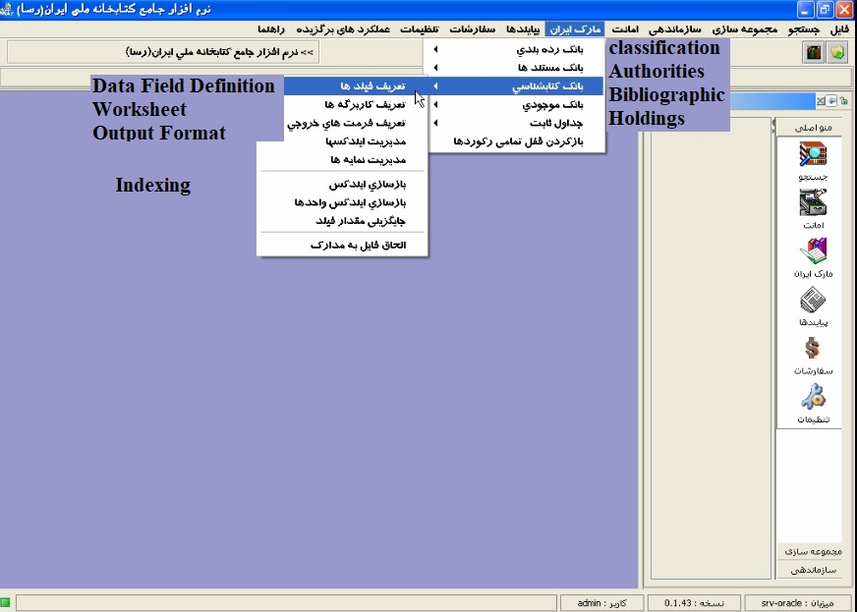
The Field Definition Table (FDT) in which the system administrator defines all the necessary fields and set their characteristics like tag, label, length, repeatability, authority Mandatory, type etc.
The worksheet, a sort of form where appear defined fields; it makes it possible to create and edit records.
The Field Selection Table (FST) defining fields where search terms are extracted from, and the techniques used for the extraction.
The format where are specified commands that output records for displaying on the screen or printing to the printer or to a file

Slide 3
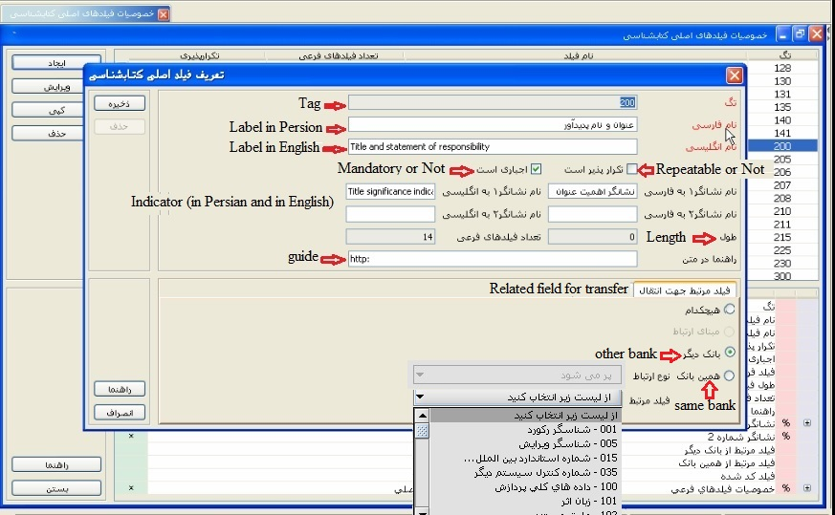

Slide 4
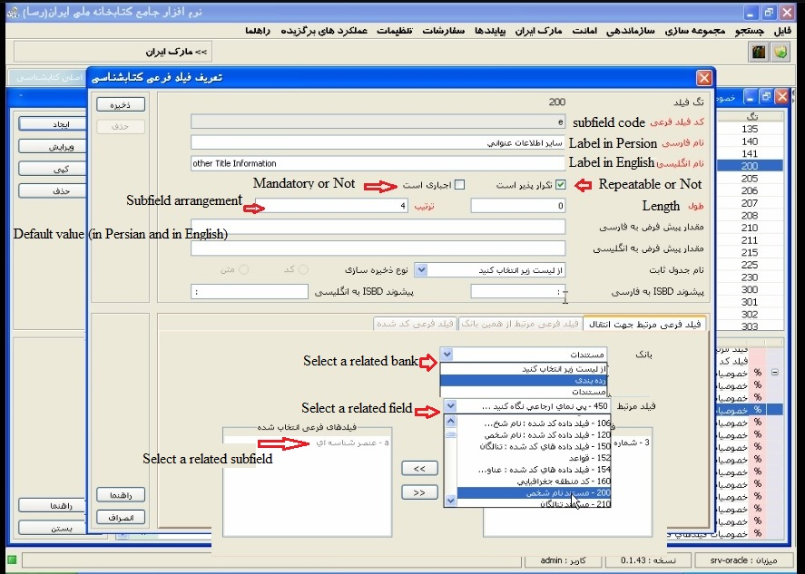

Slide 5
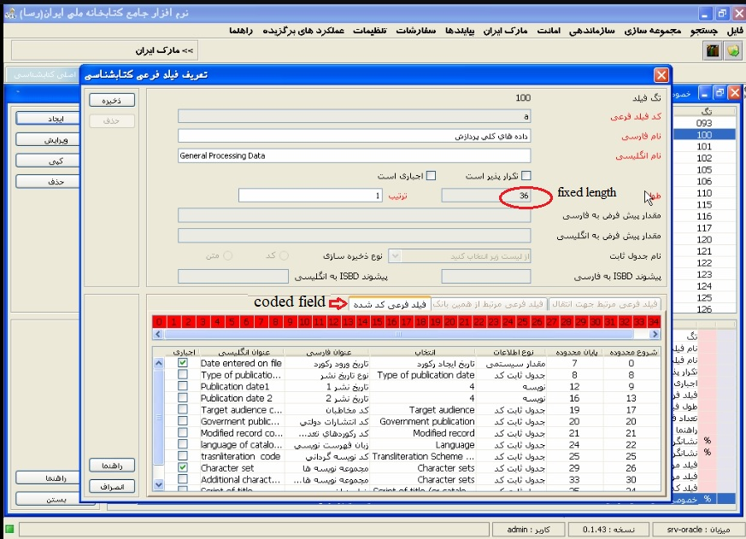
/.

Slide 6
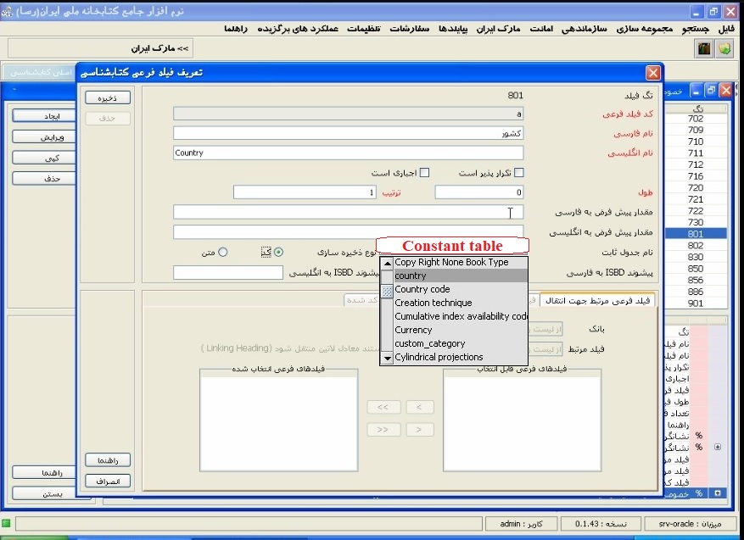

Slide 7
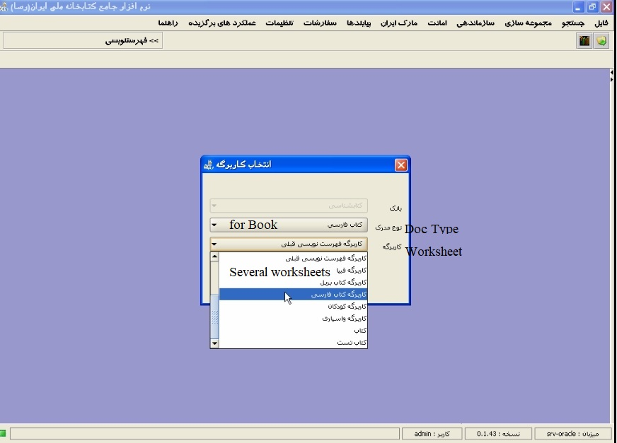
ghfcc

Slide 8
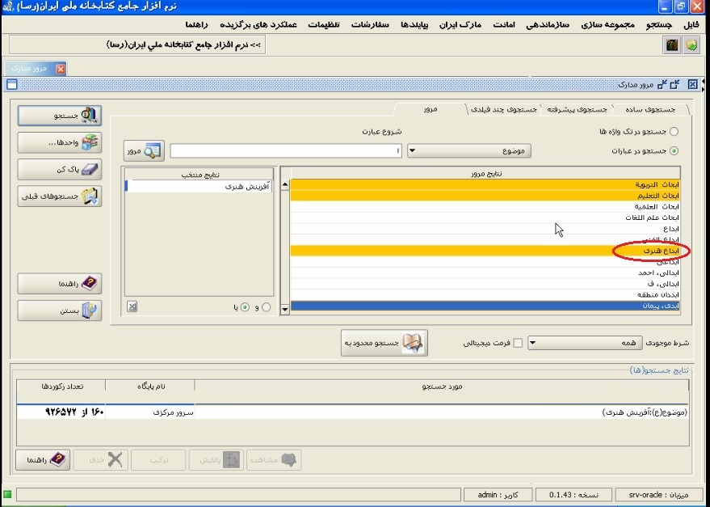
Gfvfhgffgjnczfvxfgdcdc njnjkcxgc ; b z,.kjk[pl b ;l,.;mn,mdcw3wq xvv/

Slide 9


