Slide 1

Archival description using UNIMARC: Presidential Library experience

Slide 2

Presidential Library

Slide 3
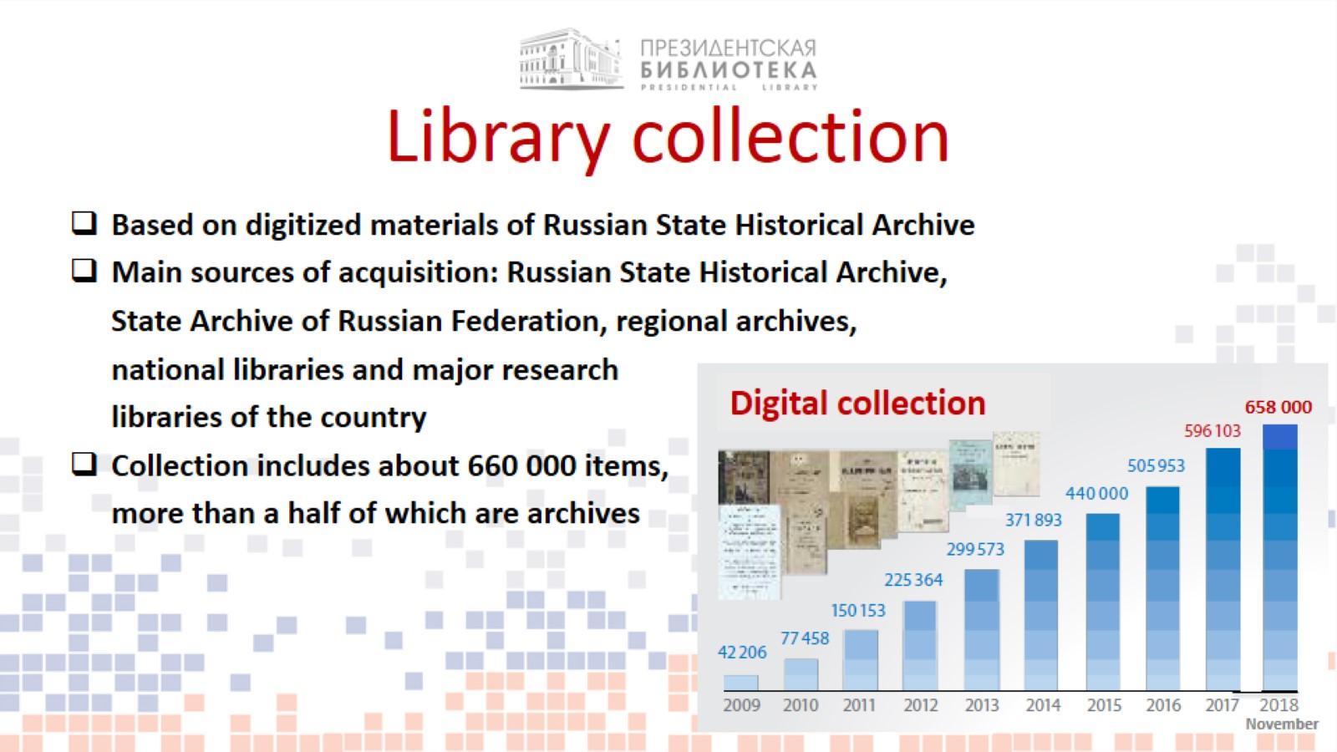
Library collection

Slide 4
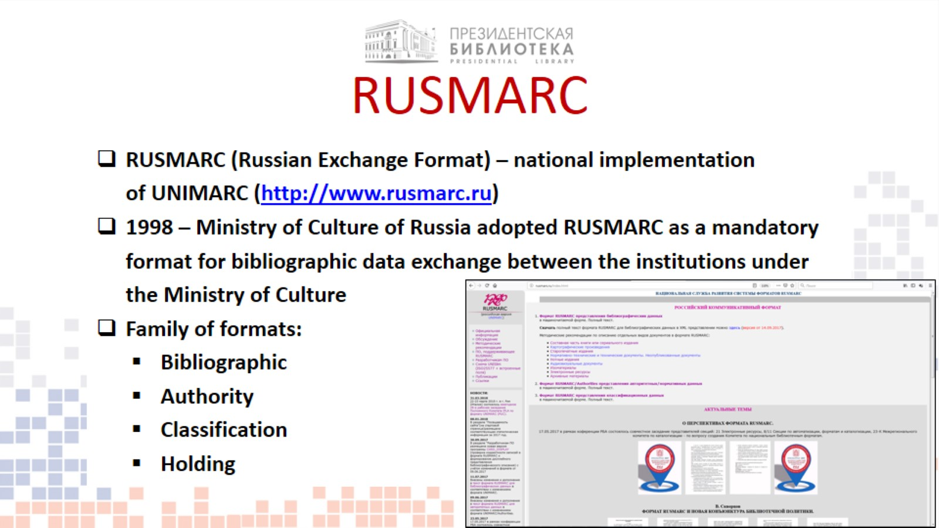
RUSMARC

Slide 5
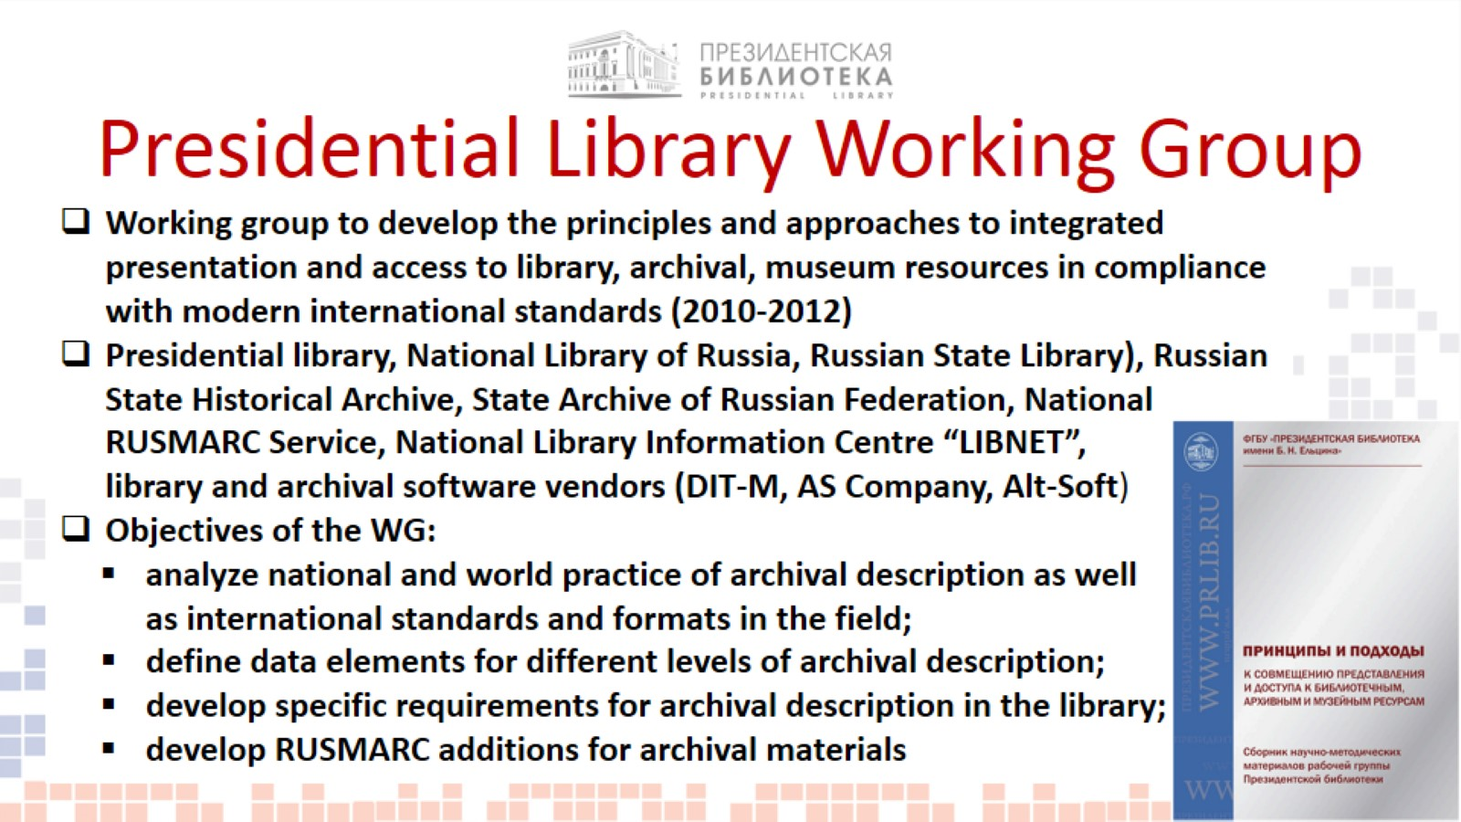
Presidential Library Working Group

Slide 6
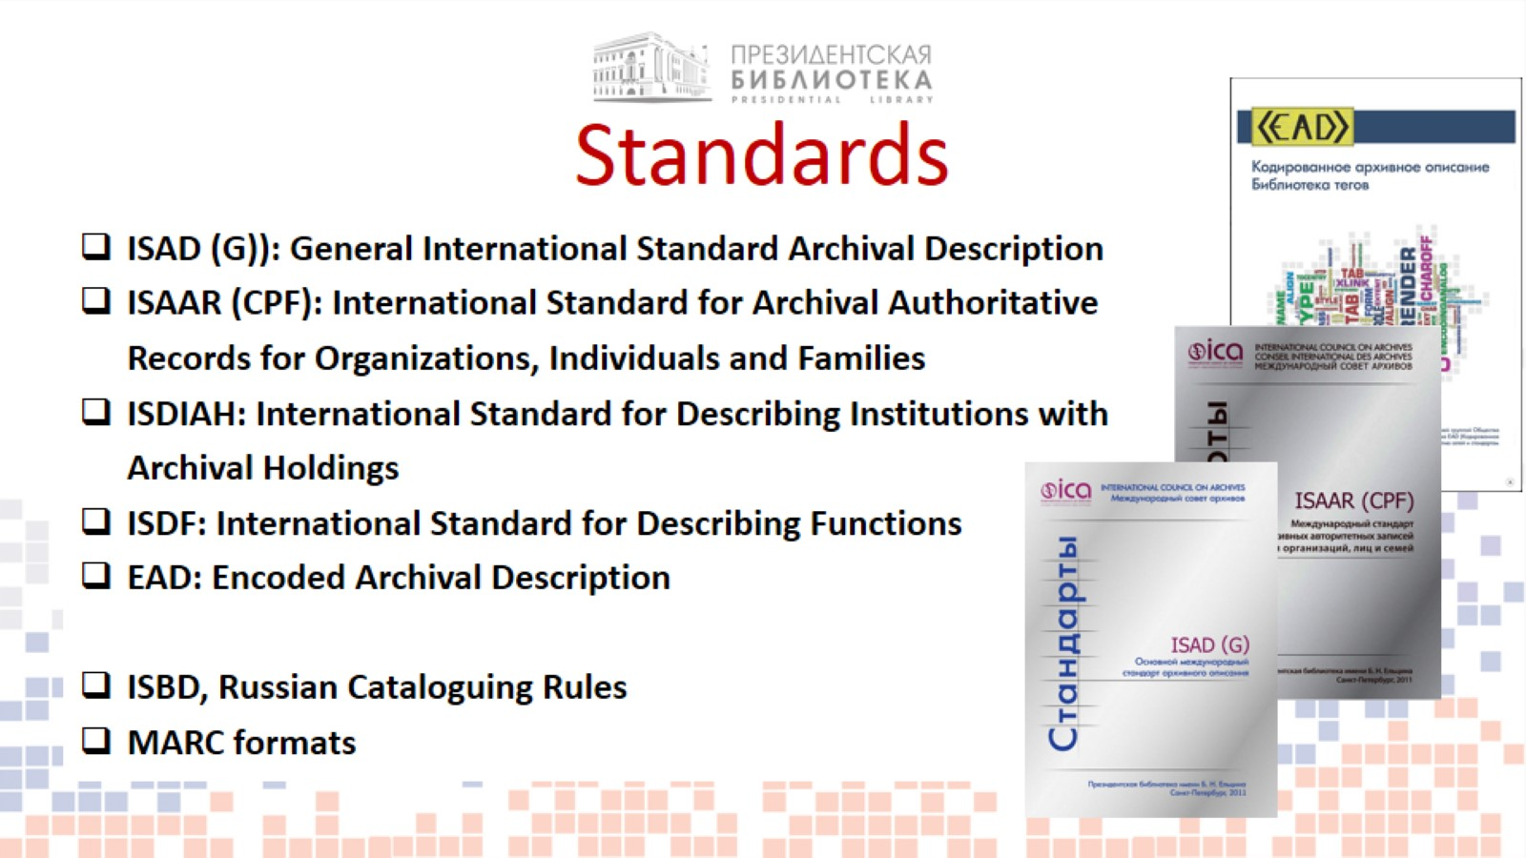
Standards

Slide 7
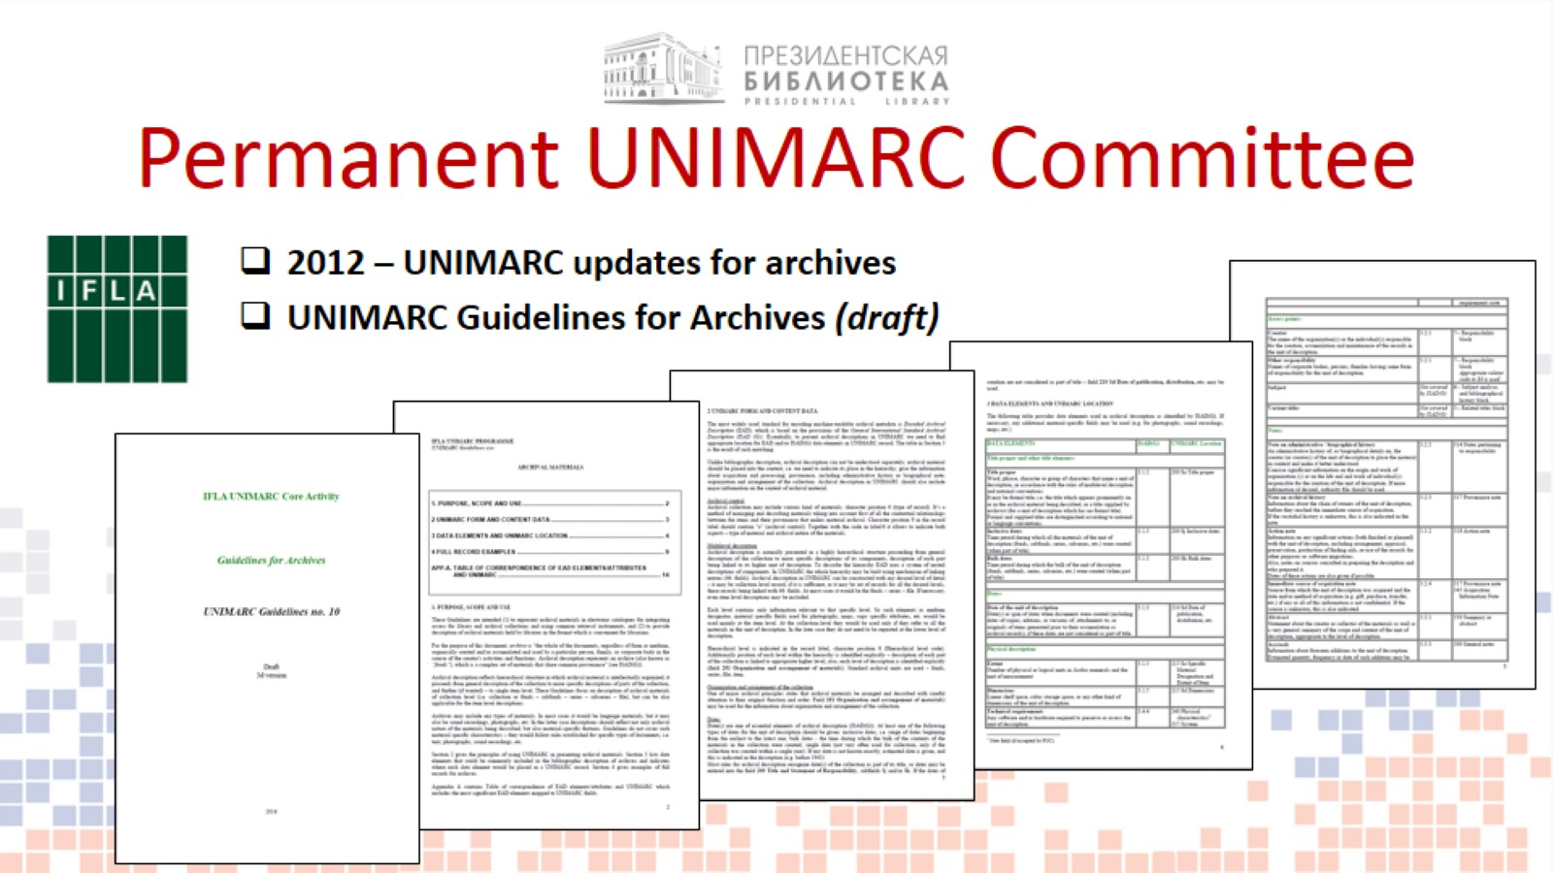
Permanent UNIMARC Committee

Slide 8
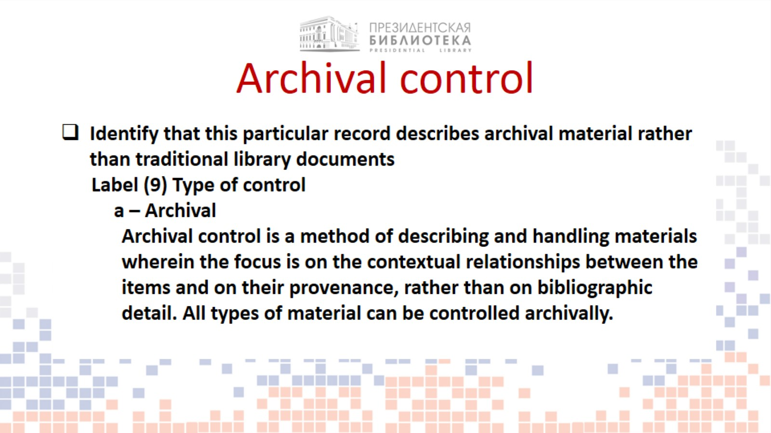
Archival control

Slide 9
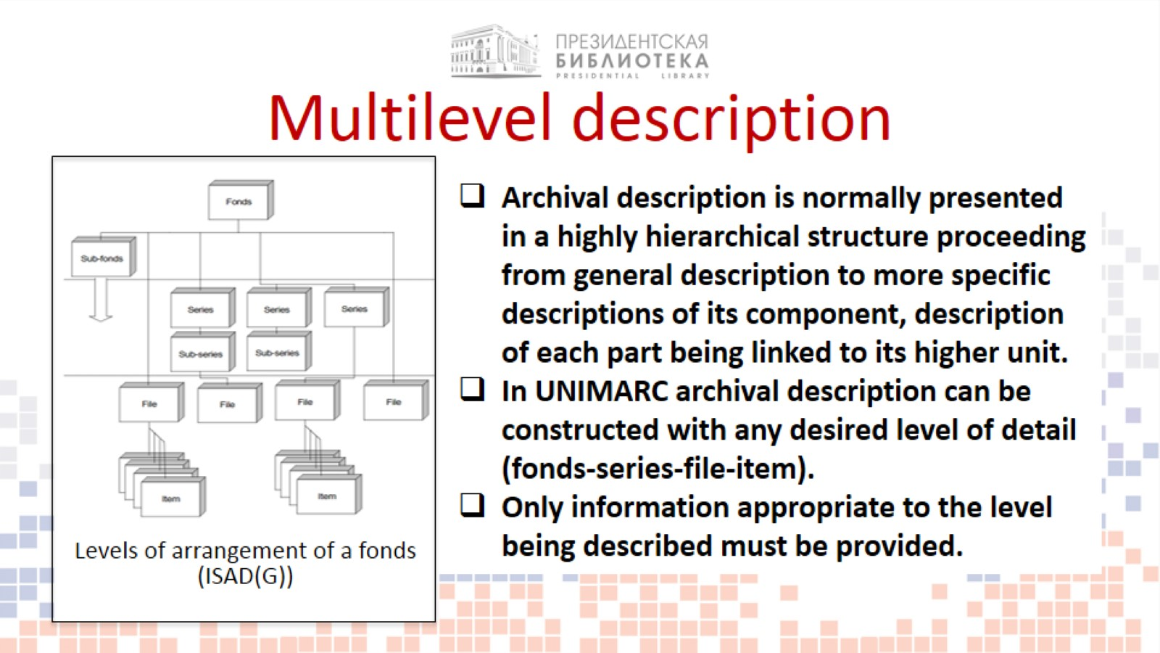
Multilevel description

Slide 10
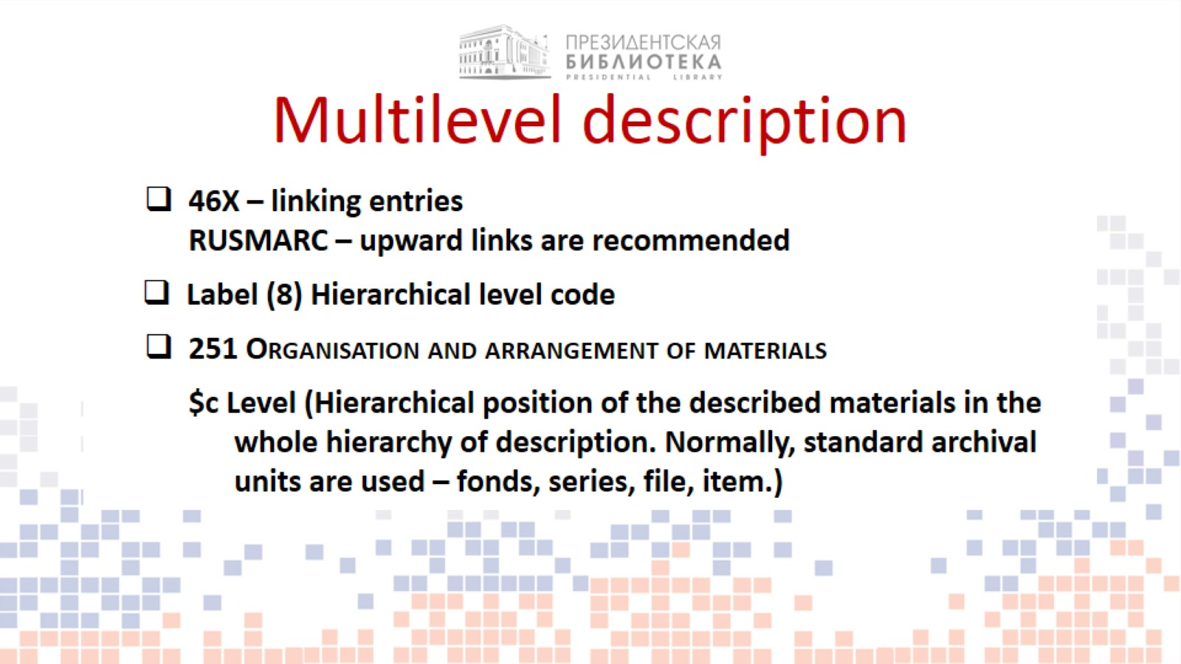
Multilevel description

Slide 11
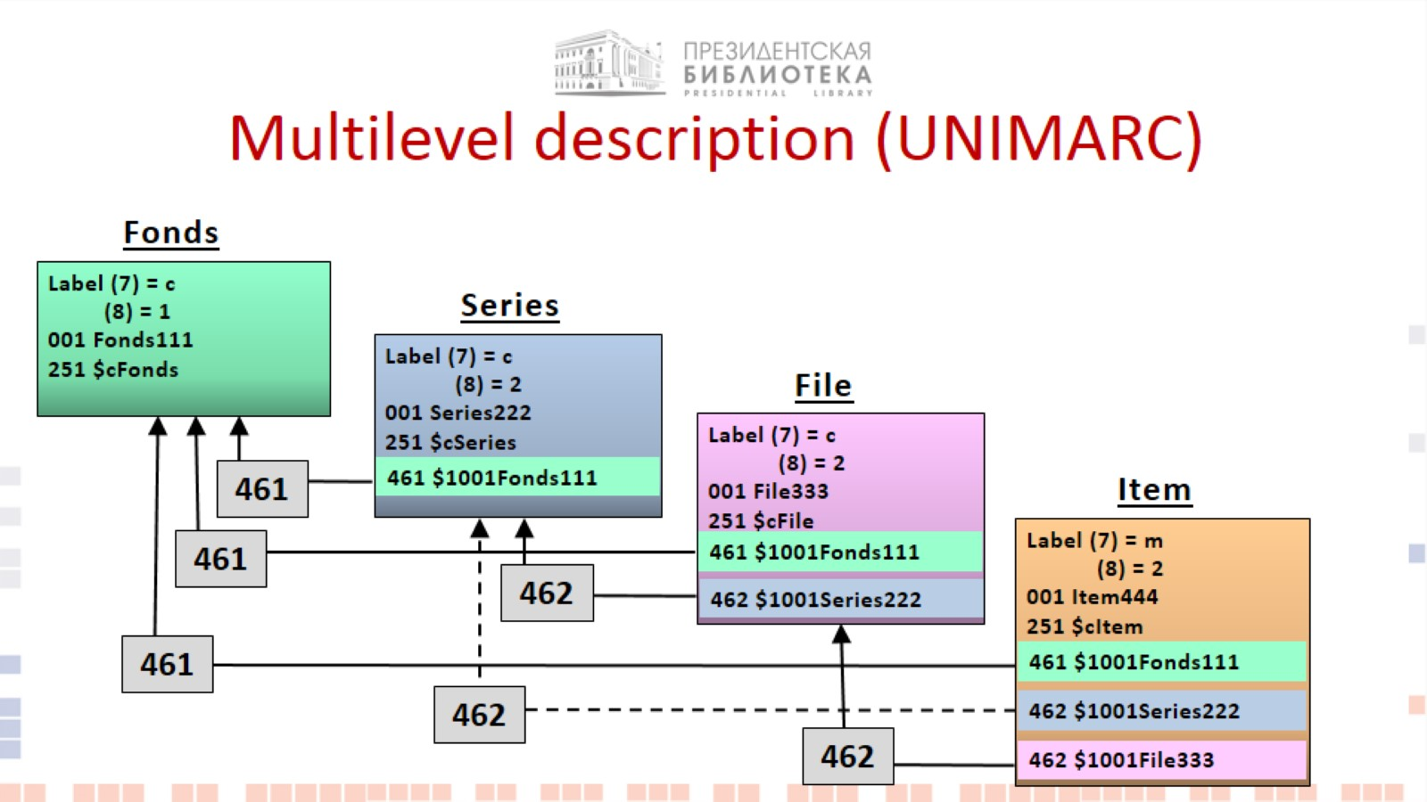
Multilevel description (UNIMARC)

Slide 12
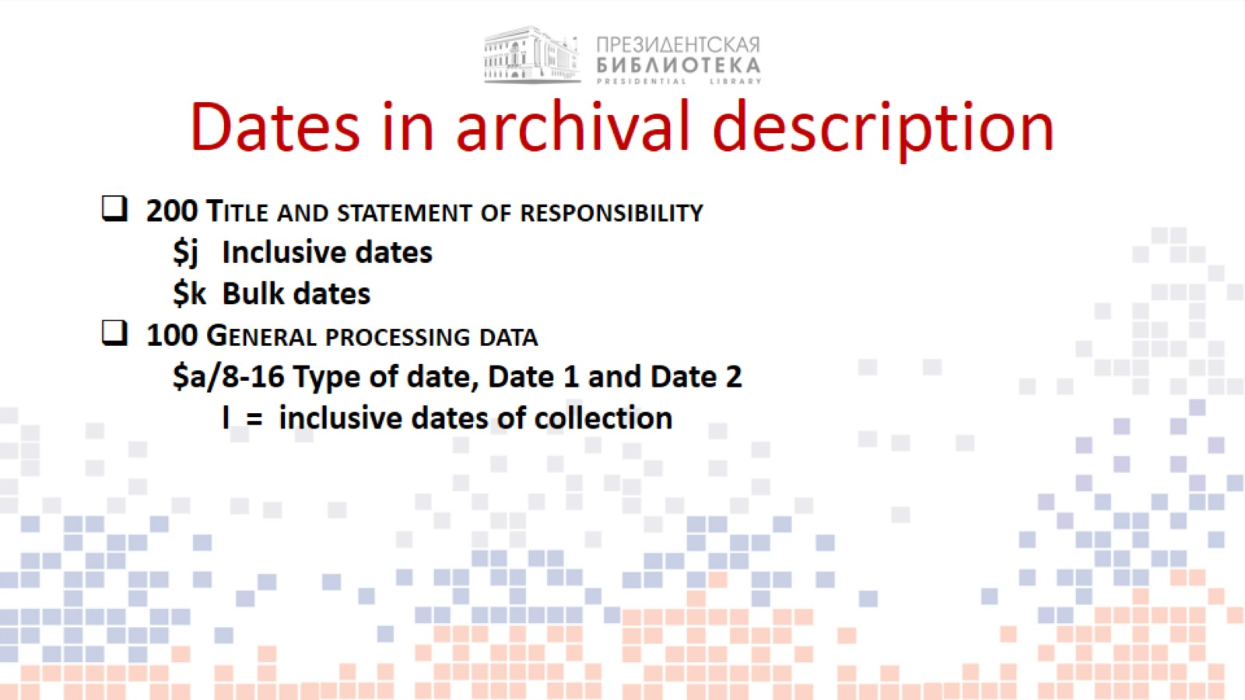
Dates in archival description

Slide 13

Best practices

Slide 14
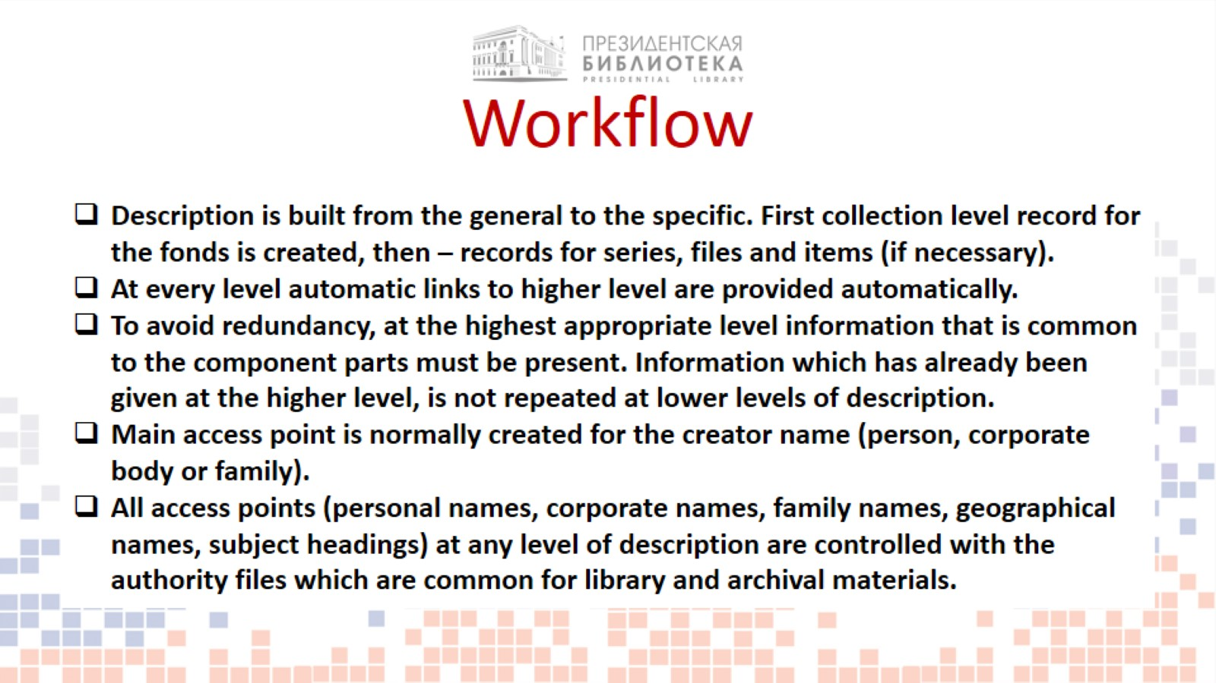
Workflow

Slide 15
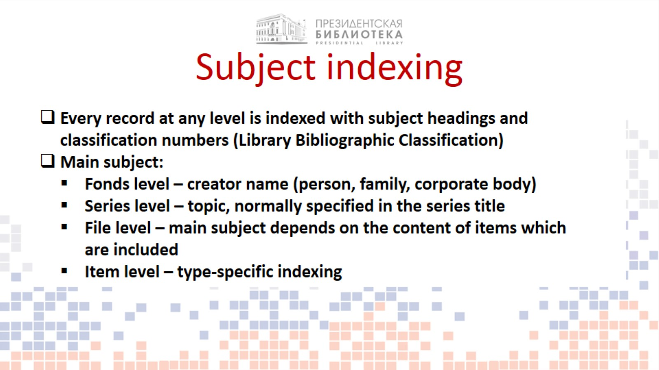
Subject indexing

Slide 16
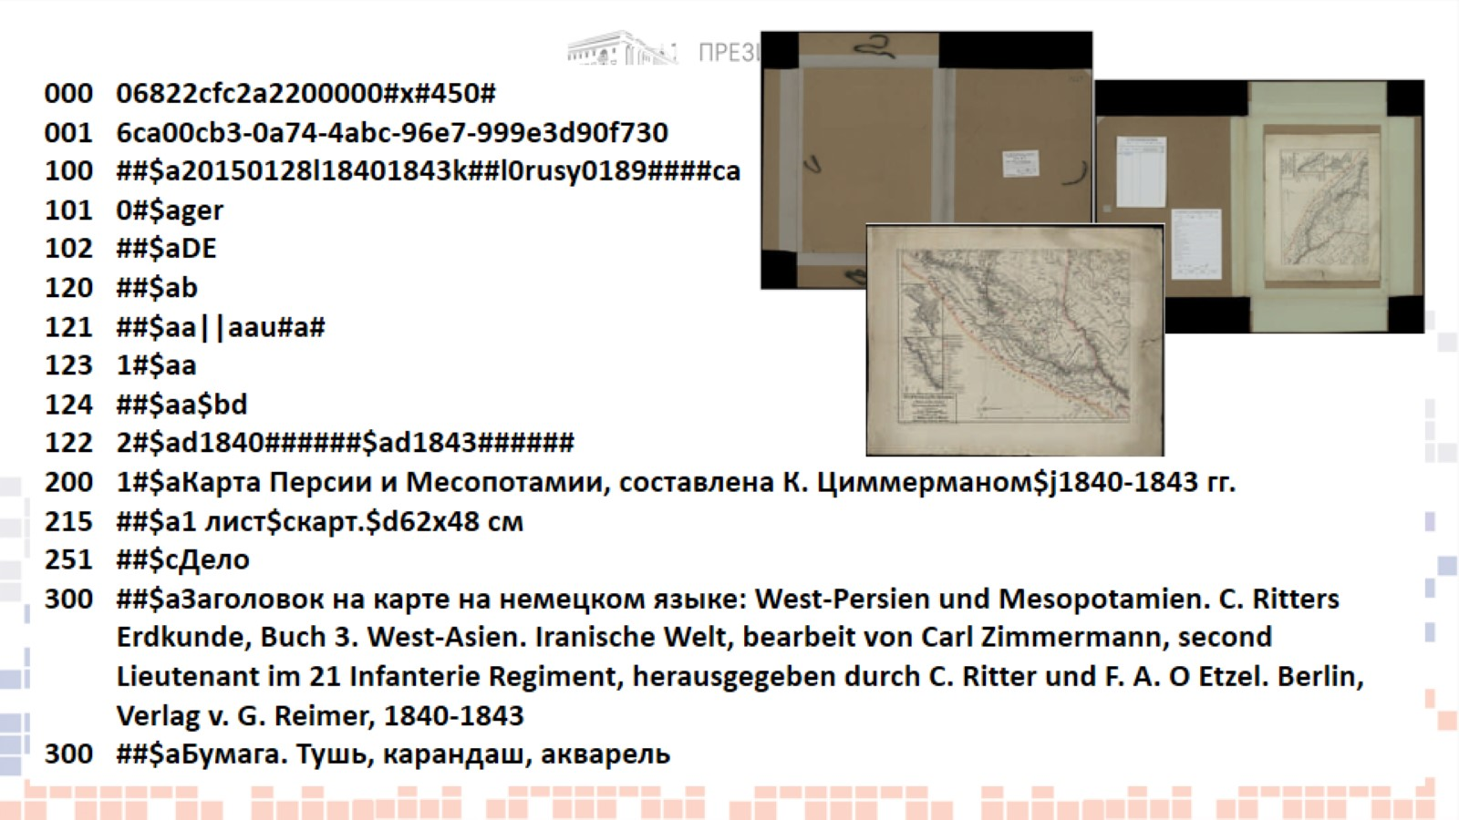

Slide 17
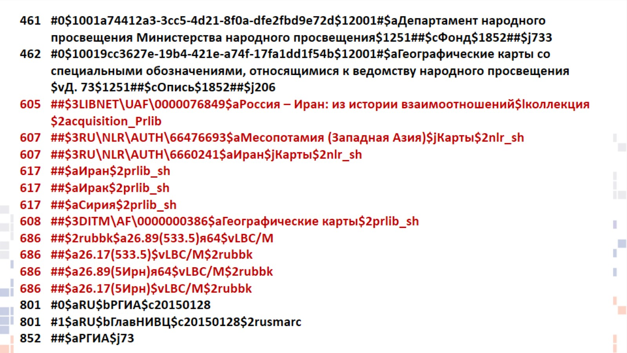

Slide 18
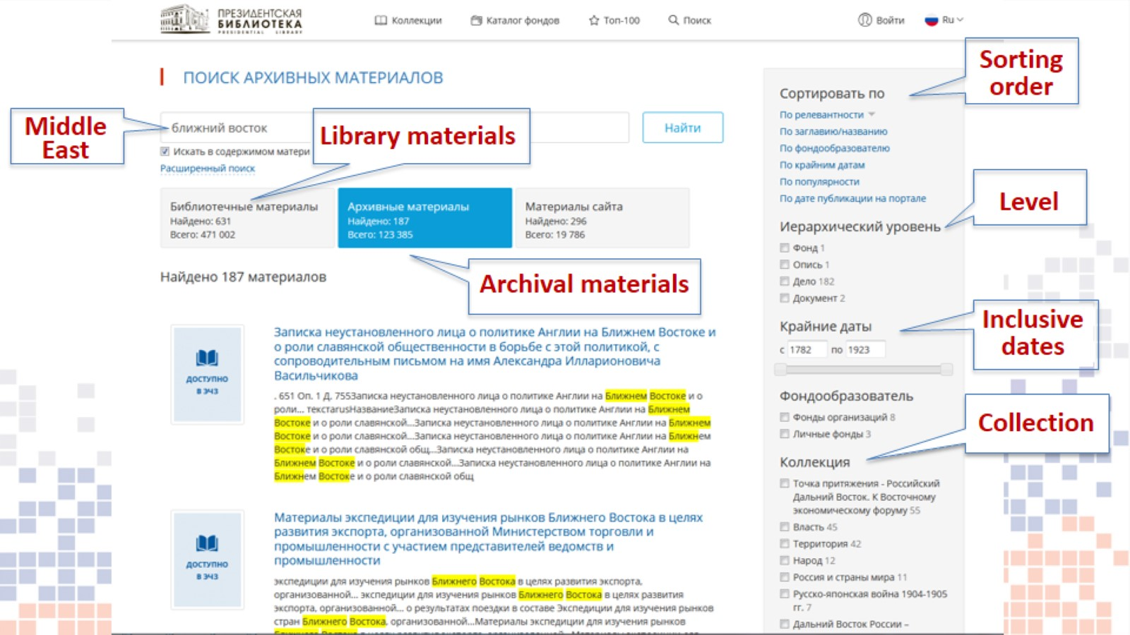

Slide 19
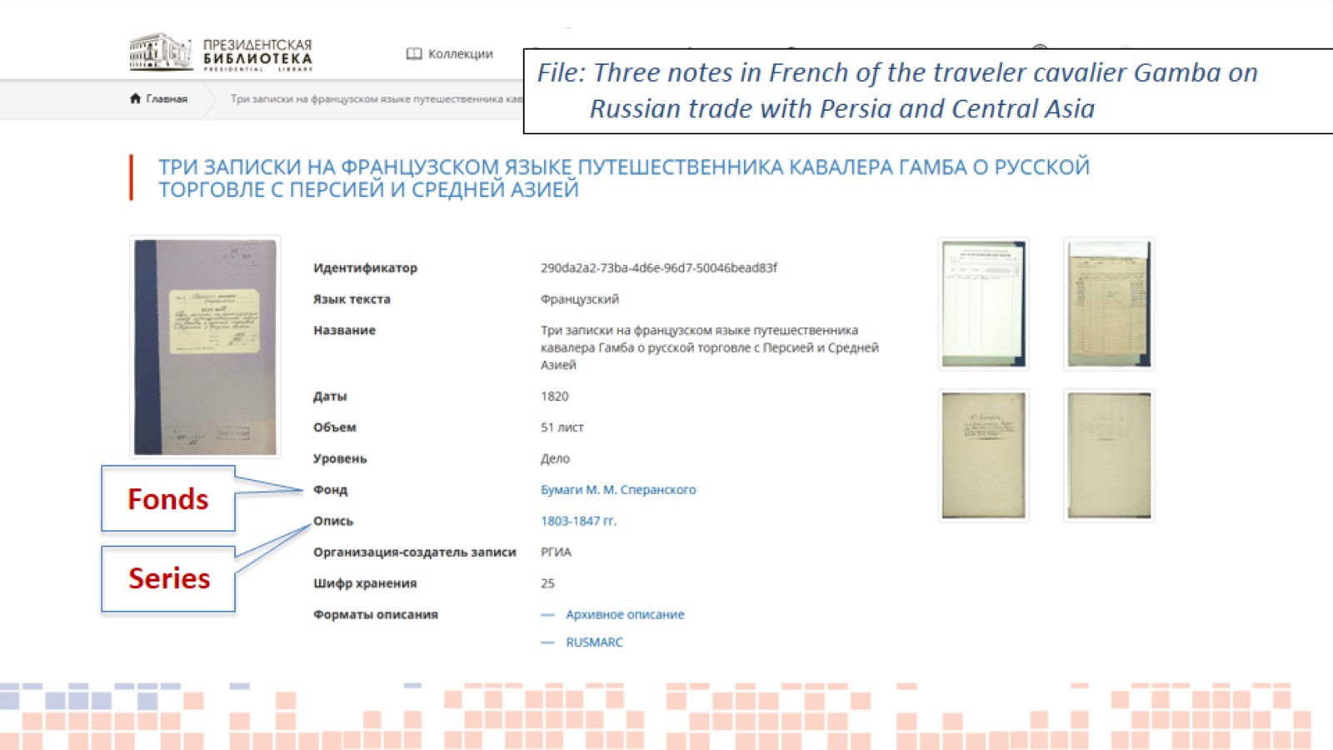
Search in the catalogue

Slide 20
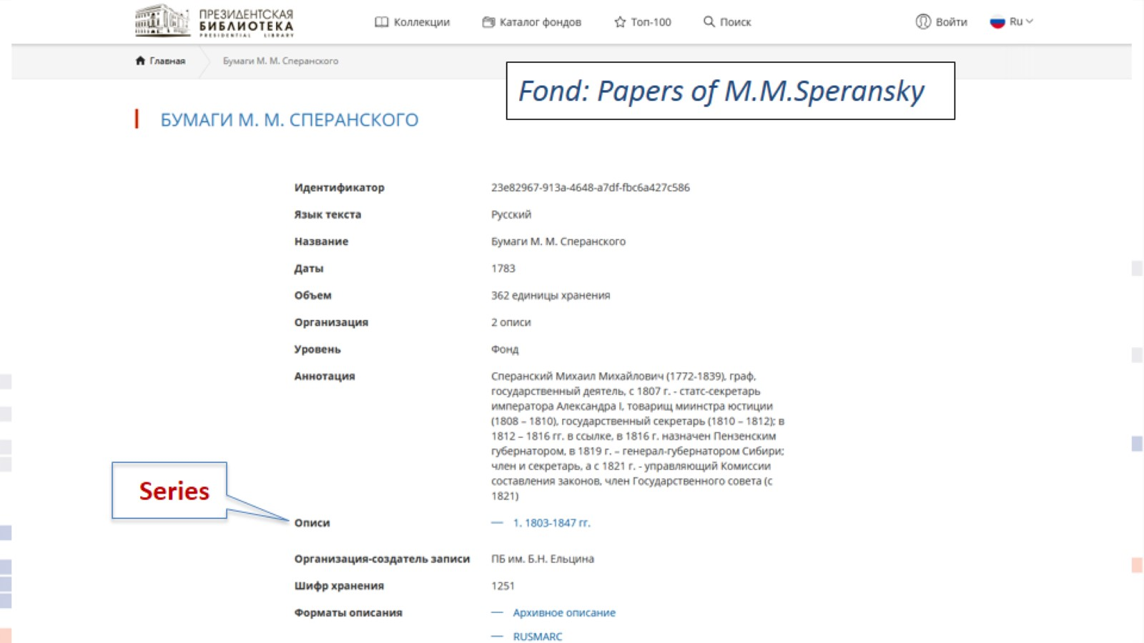
Search in the catalogue

Slide 21


