Slide 1
COBISS and CRIS in Slovenia and in Western Balkan: Interconnection and Reuse of Data
Aleš Bošnjak

Slide 2
IZUM – Institute of Information Sciences
By the Decision of the Slovenian Government IZUM was established as a non-profit public institution with the role of:
  the information service for research, education and culture
  the national bibliographic service (National COBISS Centre)

Slide 3
IZUM – Institute of Information Sciences
By the Decision of the Slovenian Government IZUM was established as a non-profit public institution with the role of:
  the information service for research, education and culture
  the national bibliographic service (National COBISS Centre)
And based on:
  the establishment of COBISS.Net and
  the free exchange of bibliographic records, created in library information systems of Albania, Bosnia and Herzegovina, Bulgaria, Montenegro, Macedonia, Slovenia and Serbia, as well as on
  the agreements with the line ministries of certain countries,

Slide 4
IZUM – Institute of Information Sciences
By the Decision of the Slovenian Government IZUM was established as a non-profit public institution with the role of:
  the information service for research, education and culture
  the national bibliographic service (National COBISS Centre)
And based on:
  the establishment of COBISS.Net and
  the free exchange of bibliographic records, created in library information systems of Albania, Bosnia and Herzegovina, Bulgaria, Montenegro, Macedonia, Slovenia and Serbia, as well as on
  the agreements with the line ministries of certain countries,
IZUM acts as:
  The regional centre for the development of integrated library systems and current research information systems

Slide 5
IZUM offers to libraries:
Being an active part of the COBISS Family (National System by the Law)
Proven organisational solutions
COBISS software for library functions
Shared cataloguing within the COBISS.net network, and access to the global catalogue(s)
Proven methodology and software to manage researchers' bibliographies and evaluation of research results
Server capacities for the COBISS and SICRIS/E-CRIS applications and services (Cloud Hosting)
Consulting, training programmes and technical support
Organisational solutions to set up the national LIS and E-CRIS system

Slide 6
IZUM: Staff and Budget
110+ employees (IT professionals and librarians)
Annual income: EUR 6.5 million
  90% from the national budget, 10% from other resources
  EUR 1.25 million for foreign databases and service licences
  EUR 300,000 for purchasing equipment

Slide 7
Members (libraries)

Slide 8
COBISS: Co-operative Online Bibliographic System and Services
An organisational model:
  National Library Information Systems with shared cataloguing, COBIB, local databases of participating libraries, CONOR authority database, COLIB database on libraries, other functions of virtual library…
Framework:
  standardised and shared processing of library materials
  a uniform management of catalogues and bibliografies
  adequately skilled cataloguers
  On-line (Internet)
  free exchange of bibliographic records
Notes:
Each national library information system built on the COBISS platform is co-created by the national COBISS centre and the libraries as members of the system. The National COBISS Centre (NCC) is a library information service that carries out the following tasks:
planning and co-ordinating activities related to linking of libraries in the COBISS system;
providing computer capacity for the operation of the system and the central services;
providing COBISS software and manuals for shared cataloguing; local library functions and other services;
managing the COBIB shared bibliographic database;
organising training and professional help to libraries and other users of COBISS software and services;
verification of suitability of library staff qualification for shared cataloguing purposes;
professional help to libraries with the conversion and transferring of data from other systems.
In Slovenia, the tasks of the National COBISS Centre are carried out by IZUM. In other countries, these are generally departments within the national library.Within the library information system based on the COBISS platform, libraries may have a status of:
the national member, which is assigned to the national library that actively participates in the shared cataloguing and performs special tasks (cataloguing national publishing output, provision of training for librarians, proficiency verification of record creators (cataloguers), cataloguing quality control, etc.);
a full member, which is assigned to any library that participates in shared cataloguing and may contribute their records into the shared bibliographic database if the cataloguers have appropriate permits/privileges for shared cataloguing. Without the appropriate permits, cataloguers are not allowed to contribute records into the shared database; they can only download records from the shared database to their local databases.

Slide 9

Shared Cataloguing

Slide 10

Shared Cataloguing

Slide 11
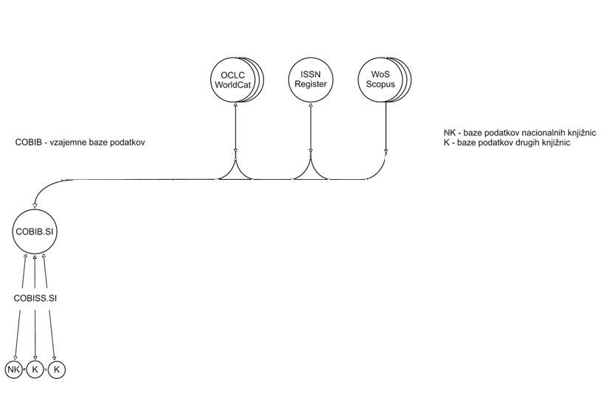
Shared Cataloguing

Slide 12
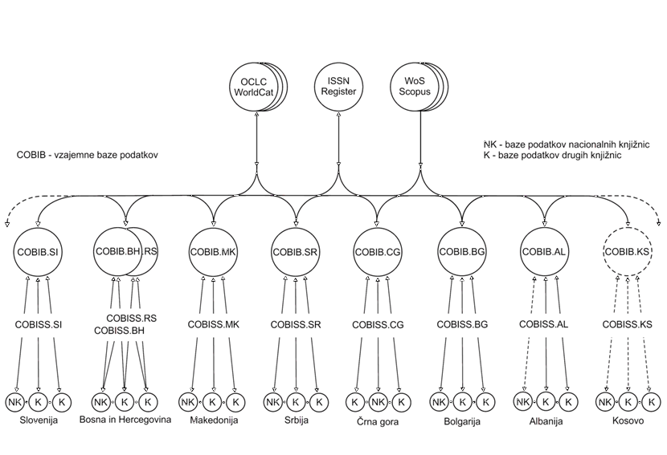
Shared Cataloguing

Slide 13
Another View
Full text
OCLC
FirstSearch
WorldCat
Library catalogues:
- LC Union Catalog
COBIB.XX
Other databases
ISSN
CONOR
LCNames
JCR
COBIB.SI
CORES
ELINKS
UDC
WoS
COLIB
Central databases
BIB
BIB
BIB
BIB
BIB
Library local databases
BIB – Local databases

Slide 14
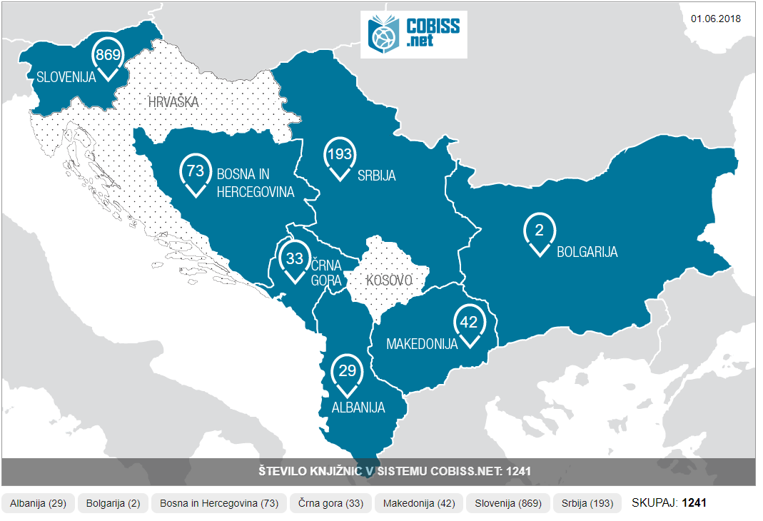
COBISS.Net

Slide 15
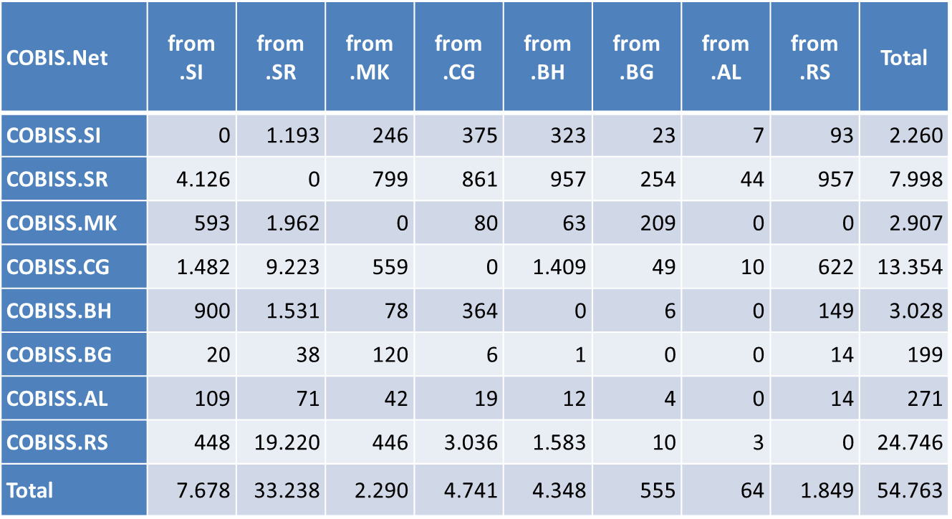
Bibliographic records exchange (in 2017)
Statistika izmenjave bibliografskih zapisov v obdobju od 1. 1. 2017 do 31. 12. 2017
Prevzeto iz COBIB.xx / COBISS.Net | .SI | .SR | .MK | .CG | .BH | .BG | .AL | .RS | Skupaj
COBISS.SI | 0 | 1.238 | 218 | 276 | 212 | 25 | 4 | 227 | 2.200
COBISS.SR | 11.040 | 0 | 2.818 | 1.411 | 1.906 | 233 | 33 | 786 | 18.227
COBISS.MK | 670 | 1.280 | 0 | 328 | 227 | 74 | 58 | 220 | 2.857
COBISS.CG | 1.620 | 7.740 | 813 | 0 | 1.312 | 22 | 24 | 1.288 | 12.819
COBISS.BH | 1.675 | 1.994 | 227 | 494 | 0 | 14 | 10 | 349 | 4.763
COBISS.BG | 38 | 42 | 22 | 6 | 1 | 0 | 0 | 3 | 112
COBISS.AL | 167 | 134 | 19 | 13 | 21 | 17 | 0 | 20 | 391
COBISS.RS | 1.575 | 27.157 | 1.126 | 4.156 | 2.120 | 35 | 9 | 0 | 36.178
Skupaj | 16.785 | 39.585 | 5.243 | 6.684 | 5.799 | 420 | 138 | 2.893 | 77.547
Notes:
1.2 M new records in 2016 (total –all local databases)
74 % of all new records were downloaded (from somewhere)

Slide 16
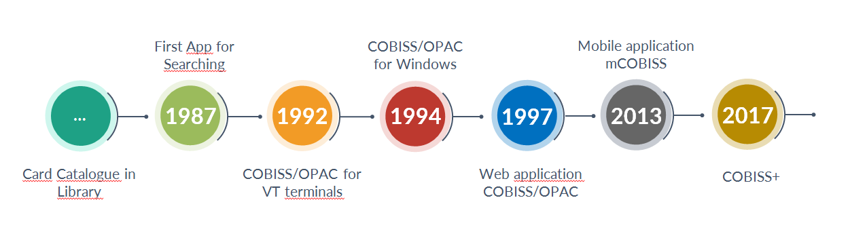
Access to Information in Libraries – 30 Years Evolution

Slide 17
Segments
COBISS/Cataloguing
COBISS/Loan
COBISS+ (ex COBISS/OPAC)
COBISS/Acquisition
COBISS/Serials
COBISS/Holdings
COBISS/Inter-library Loan
COBISS/Reports
COBISS/App Management
COBISS/E-resources
COBISS/Bibliographies
SICRIS / E-CRIS
MyLibrary
Portal Education

Slide 18
Jobs To Do
Development, Maintenance & Management (Services, Apps, …)
Shared Cataloguing
COBISS+ (COBISS/OPAC)
Local Applications
Education
Research Processes Support
Infrastructure (SW, HW, Comm)
Documentation

Slide 19
SICRIS / E-CRIS
National Current Research Information System
SICRIS (Slovenia)
E-CRIS (Albania, Bosnia & Herzegovina, Montenegro, Macedonia, Serbia)
SICRIS is developed and maintained by IZUM and Slovenian Research Agency (ARRS)
Research entities: research organisations and research groups with registered employees, researchers, research projects and research programmes

Slide 20
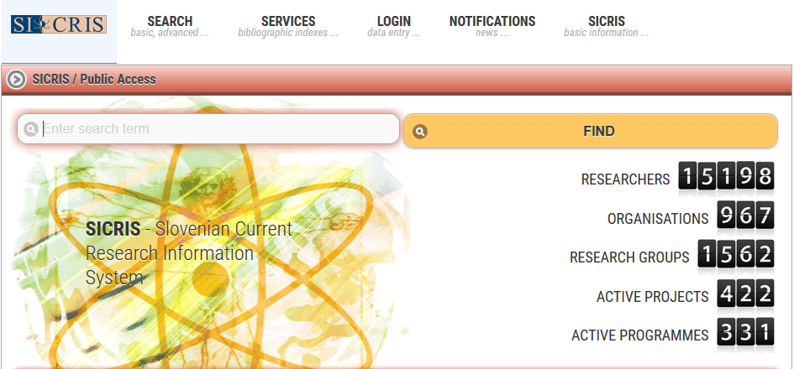
SICRIS Homepage
SICRIS homepage (sicris.izum.si) with current numbers of research entities:

Slide 21
Researchers‘ Bibliographies
Bibliographies is one of the COBISS web applications
Researchers‘ Bibliographies connects COBISS and SICRIS systems
COBISS.net: personal and representative bibliographies
COBISS.SI also includes:
  evaluation of bibliographic indicators of scientific performance according to the ARRS methodology and rules
  evaluation for the purposes od awarding habilitation titles in the three largest universities in Slovenia
  data from Web of Science and Scopus (JCR, SNIP, citations)
COBIB.SI bibliographic database: one third of all bibliographic records (1,7 million) belongs to researchers‘ bibliographies with
  researcher‘s code
  type of work: Typology of Document/works for Bibliography Management in COBISS

Slide 22
Other services:
mCOBISS
eBooks
Mobile Library (Bibliobus)
Hosting
Ask a Librarian
Journal OZ
Foreign Databases & Services
Most Read Books
Public Lending Rights Provision
Social Networks
Special Servers
Libroam
COBISS AAI
COBISS/SciMet
Alternative Impact Metrics

Slide 23
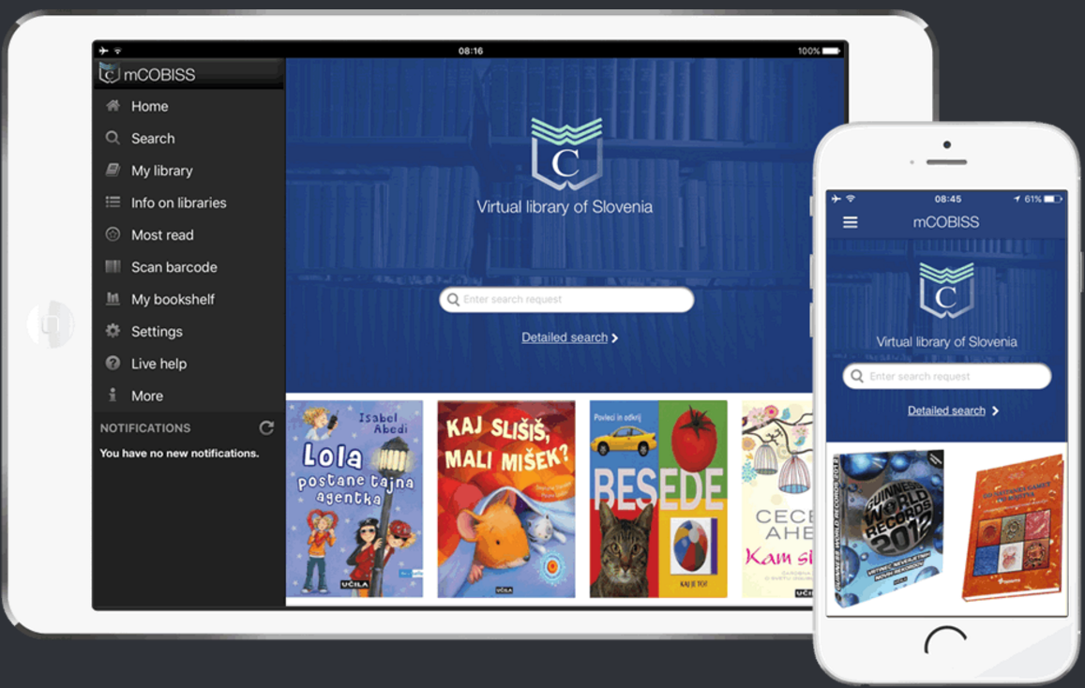
mCOBISS
mCOBISS
eBooks
Mobile Library (Bibliobus)
Hosting
Ask a Librarian
Journal OZ
Foreign Databases & Services
Most Read Books
Public Lending Rights Provision
Social Networks
Special Servers
Libroam
COBISS AAI
COBISS/SciMet
Alternative Impact Metrics
Virtual Library on mobile devices
Slovenia, Bosnia & Herzegovina, Serbia

Slide 24

eBooks
mCOBISS
eBooks
Mobile Library (Bibliobus)
Hosting
Ask a Librarian
Journal OZ
Foreign Databases & Services
Most Read Books
Public Lending Rights Provision
Social Networks
Special Servers
Libroam
COBISS AAI
COBISS/SciMet
Alternative Impact Metrics
Demand based on the user‘s point of view:
No difference between paper and bits.
Period.
Searching in OPAC
(paper)
COBISS
Searching in OPAC
(e-book)
Databases
Catalogues
Servers
Transactions
…
Interface
Provider:
Searching
Transactions

Slide 25
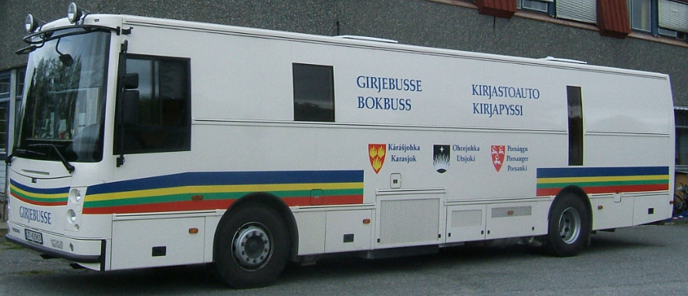

Mobile Library (Bibliobus)
mCOBISS
eBooks
Mobile Library (Bibliobus)
Hosting
Ask a Librarian
Journal OZ
Foreign Databases & Services
Most Read Books
Public Lending Rights Provision
Social Networks
Special Servers
Libroam
COBISS AAI
COBISS/SciMet
Alternative Impact Metrics
Travelling library departments
Bring books to people
Rural areas

Slide 26
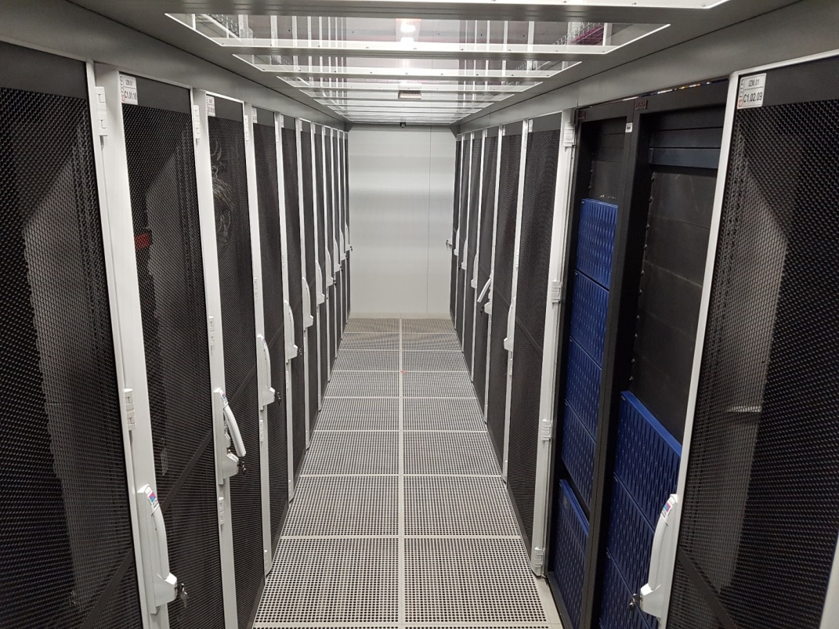
Hosting
mCOBISS
eBooks
Mobile Library (Bibliobus)
Hosting
Ask a Librarian
Journal OZ
Foreign Databases & Services
Most Read Books
Public Lending Rights Provision
Social Networks
Special Servers
Libroam
COBISS AAI
COBISS/SciMet
Alternative Impact Metrics
Cloud (in fact, it‘s underground ☺)
Sophisticated up-to-date data centre
Data duplications and backups
System SW environment, 3rd party SW, licensing

Slide 27
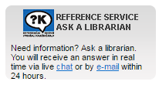
Ask a Librarian
mCOBISS
eBooks
Mobile Library (Bibliobus)
Hosting
Ask Librarian
Journal OZ
Foreign Databases & Services
Most Read Books
Public Lending Rights Provision
Social Networks
Special Servers
Libroam
COBISS AAI
COBISS/SciMet
Alternative impact metrics
Free online reference service
Real-time chat or e-mail
Replies within 24 hours
Assistance: specially trained librarians and information professionals (IZUM and participating libraries)
Supported by QuestionPoint

Slide 28
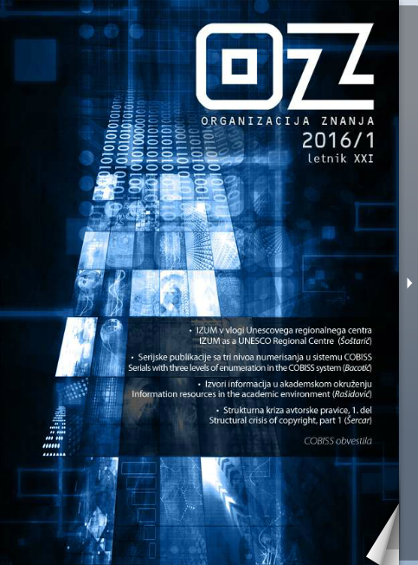
Journal OZ
mCOBISS
eBooks
Mobile Library (Bibliobus)
Hosting
Ask a Librarian
Journal OZ
Foreign Databases & Services
Most Read Books
Public Lending Rights Provision
Social Networks
Special Servers
Libroam
COBISS AAI
COBISS/SciMet
Alternative Impact Metrics
OZ: Organizacija znanja
Born in 1996
2014 → e-only
Indexed in WorldCat, ProQuest…

Slide 29
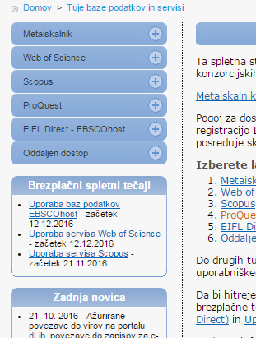
Foreign Databases and Services
mCOBISS
eBooks
Mobile Library (Bibliobus)
Hosting
Ask a Librarian
Journal OZ
Foreign Databases & Services
Most Read Books
Public Lending Rights Provision
Social Networks
Special Servers
Libroam
COBISS AAI
COBISS/SciMet
Alternative Impact Metrics
Consortia agreement
Special limitations may occur
ISSN
OCLC (incl. WorldCat)
LC/NAF
JCR

Slide 30
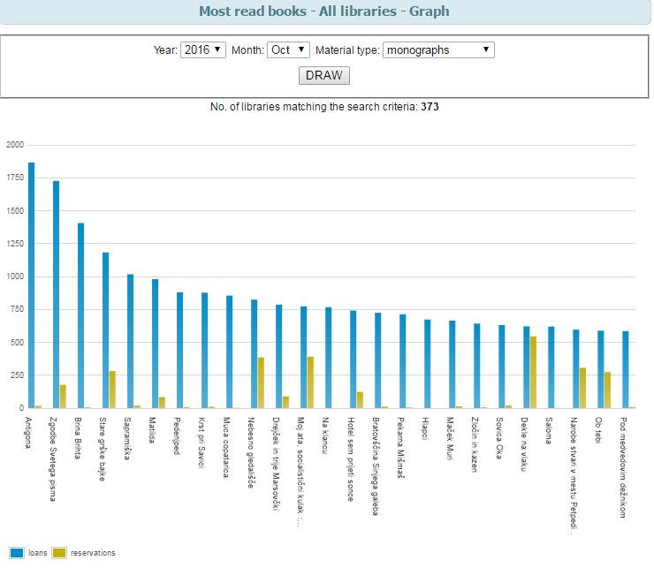
Most Read Books
mCOBISS
eBooks
Mobile Library (Bibliobus)
Hosting
Ask a Librarian
Journal OZ
Foreign Databases & Services
Most Read Books
Public Lending Rights Provision
Social Networks
Special Servers
Libroam
COBISS AAI
COBISS/SciMet
Alternative Impact Metrics
the most frequently borrowed books
all libraries with automated circulation/loan

Slide 31
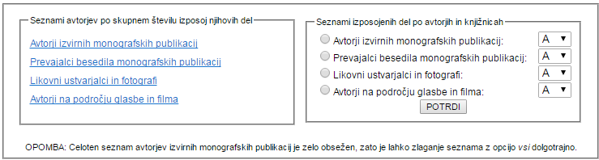
Public Lending Rights Provision
mCOBISS
eBooks
Mobile Library (Bibliobus)
Hosting
Ask a Librarian
Journal OZ
Foreign Databases & Services
Most Read Books
Public Lending Rights Provision
Social Networks
Special Servers
Libroam
COBISS AAI
COBISS/SciMet
Alternative Impact Metrics
Following EU legislation
Ministry of Culture & Slovenian Book Agency
Statistics of circulation/loan in public libraries
Money … Money … Money

Slide 32

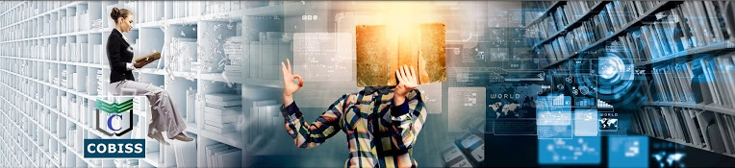
Social Networks
mCOBISS
eBooks
Mobile Library (Bibliobus)
Hosting
Ask a Librarian
Journal OZ
Foreign Databases & Services
Most Read Books
Public Lending Rights Provision
Social Networks
Special Servers
Libroam
COBISS AAI
COBISS/SciMet
Alternative Impact Metrics
Facebook
Twitter
YouTube
Blog

Slide 33
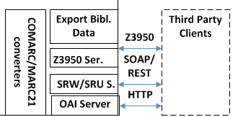
Special Servers
mCOBISS
eBooks
Mobile Library (Bibliobus)
Hosting
Ask a Librarian
Journal OZ
Foreign Databases & Services
Most Read Books
Public Lending Rights Provision
Social Networks
Special Servers
Libroam
COBISS AAI
COBISS/SciMet
Alternative Impact Metrics
Z39.50; SRW/SRU; OAI-PMH
access to bibliographic databases
particular agreements
LDAP to authenticate library users
SIP2 for operations supporting devices

Slide 34
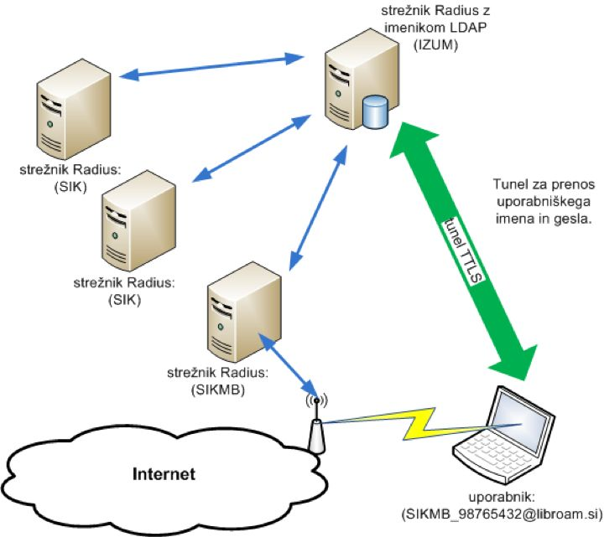
Libroam
mCOBISS
eBooks
Mobile Library (Bibliobus)
Hosting
Ask a Librarian
Journal OZ
Foreign Databases & Services
Most Read Books
Public Lending Rights Provision
Social Networks
Special Servers
Libroam
COBISS AAI
COBISS/SciMet
Alternative Impact Metrics
Library Roaming - Free secure WiFi for patrons
Eduroam clone
No extra username/password management

Slide 35
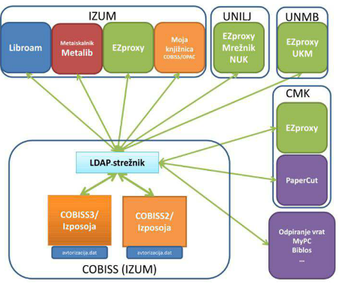
COBISS AAI
mCOBISS
eBooks
Mobile Library (Bibliobus)
Hosting
Ask a Librarian
Journal OZ
Foreign Databases & Services
Most Read Books
Public Lending Rights Provision
Social Networks
Special Servers
Libroam
COBISS AAI
COBISS/SciMet
Alternative Impact Metrics
Authentication Authorization Infrastructure
LDAP + Shibboleth
Single Sign-On
Digital Identity

Slide 36
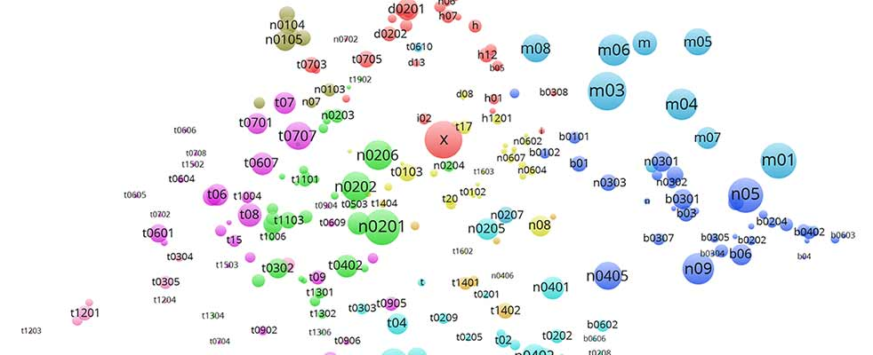
COBISS/SciMet
mCOBISS
eBooks
Mobile Library (Bibliobus)
Hosting
Ask a Librarian
Journal OZ
Foreign Databases & Services
Most Read Books
Public Lending Rights Provision
Social Networks
Special Servers
Libroam
COBISS AAI
COBISS/SciMet
Alternative Impact Metrics
Monitoring scientific production
COBISS & SICRIS WoS & Scopus
Statistics, Comparisons, Top 100 …

Slide 37
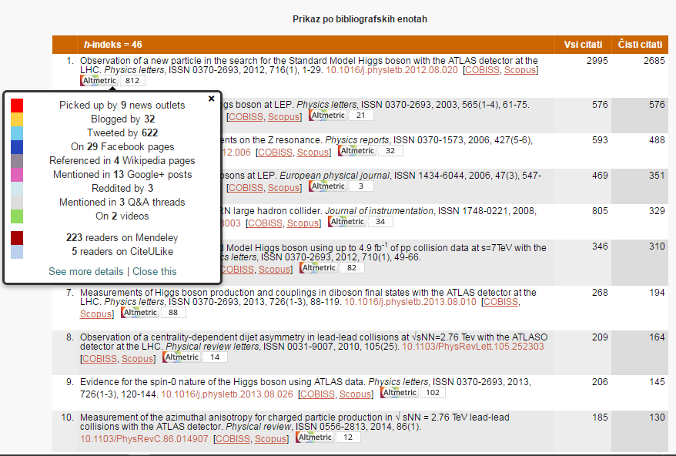
Alternative Impact Metrics
mCOBISS
eBooks
Mobile Library (Bibliobus)
Hosting
Ask Librarian
Journal OZ
Foreign Databases & Services
Most Read Books
Public Lending Rights Provision
Social Networks
Special Servers
Libroam
COBISS AAI
COBISS/SciMet
Alternative Impact Metrics
Traditional: citations, h-indices, etc.
New thinking:
reach of research on the Internet
data from social networks, blogs, news…

Slide 38
